Slide 1
EMPLOYEE ATTRITION PROBLEM
Hash Analytics Internship
Proof of Concept

Slide 2

HELLO!
I am Abiola Adeyinka Mariam
I am here to present my insights on the employee attrition problem for the HashAnalytics Internship project.
You can find me at LinkedIn: Adeyinka Abiola

Slide 3
Process
1
2
3
4
Understand the problem statement
Understand the data and the features
Exploratory Analysis using Visualizations
Observations and Recommendations
Understanding the objectives and goals of the companys problem.
Understanding what each feature represents and their importance to the target value.
Using visualizations to get insights of what the data can tell us and gaining insights.
Answering the objectives of the problem and providing reasonable solutions

Slide 4
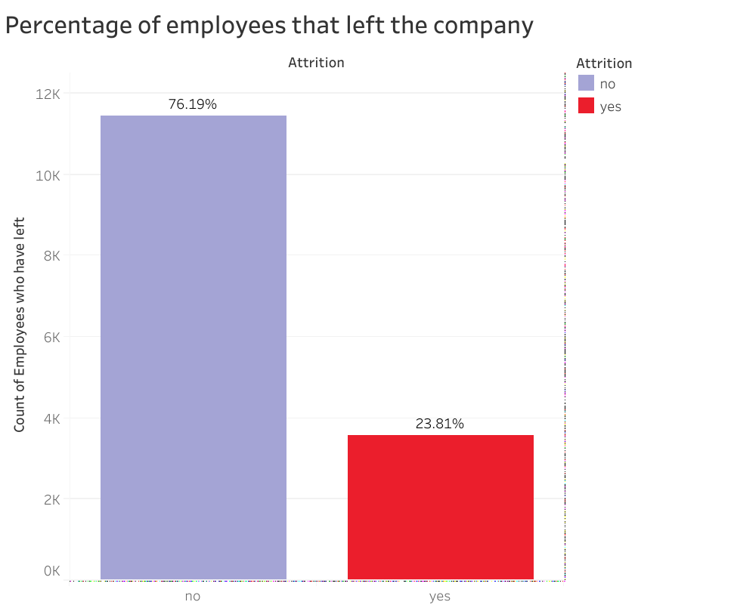
Problem Statement
1
Company X is trying to control employee attrition using 9 features to determine the employees that leave the company.
About 23.8% of employees have left so far.

Slide 5
Why are employees leaving?
What type of employees are leaving?

Slide 6
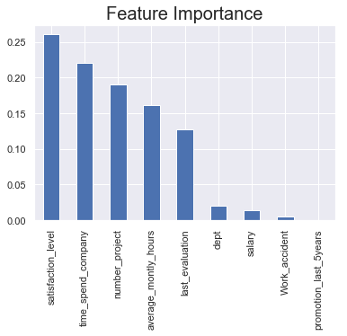
Feature Importance
Observations
This shows that statistical level, time spent in the company, number of projects, average monthly hours and last evaluation of an employee have more importance in determining the attrition of an employee.

Slide 7
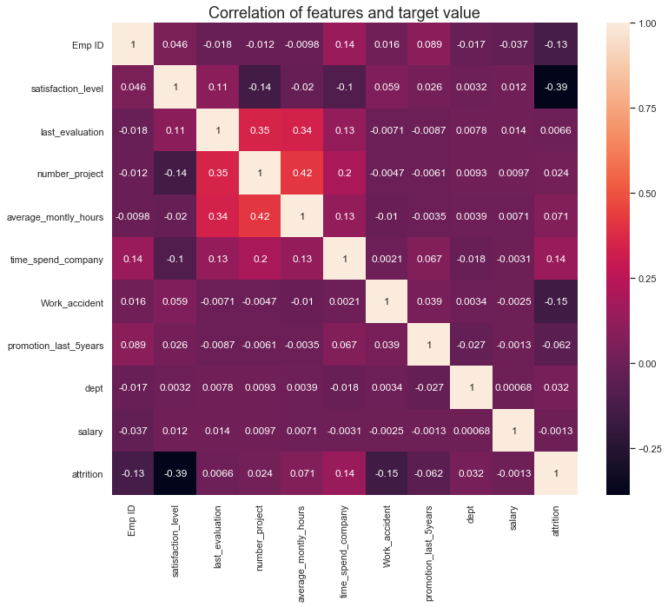
Explorative Analysis
There is a high negative correlation between satisfaction level and the attrition .
I assume that employees with a lower satisfaction level leave the company more.
Why do they have lower satisfaction level?
There is also a high correlation between number of projects, average monthly hours and last evaluation.
Lets dig further.

Slide 8
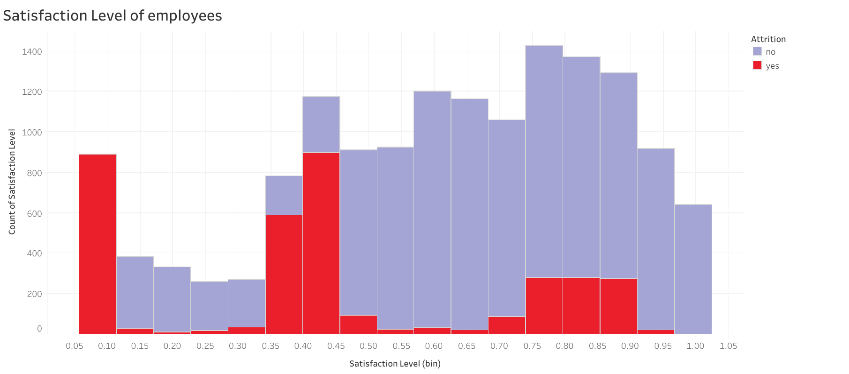
Satisfaction Level
Why is there a high spike for employees that left with low satisfaction level?

Slide 9
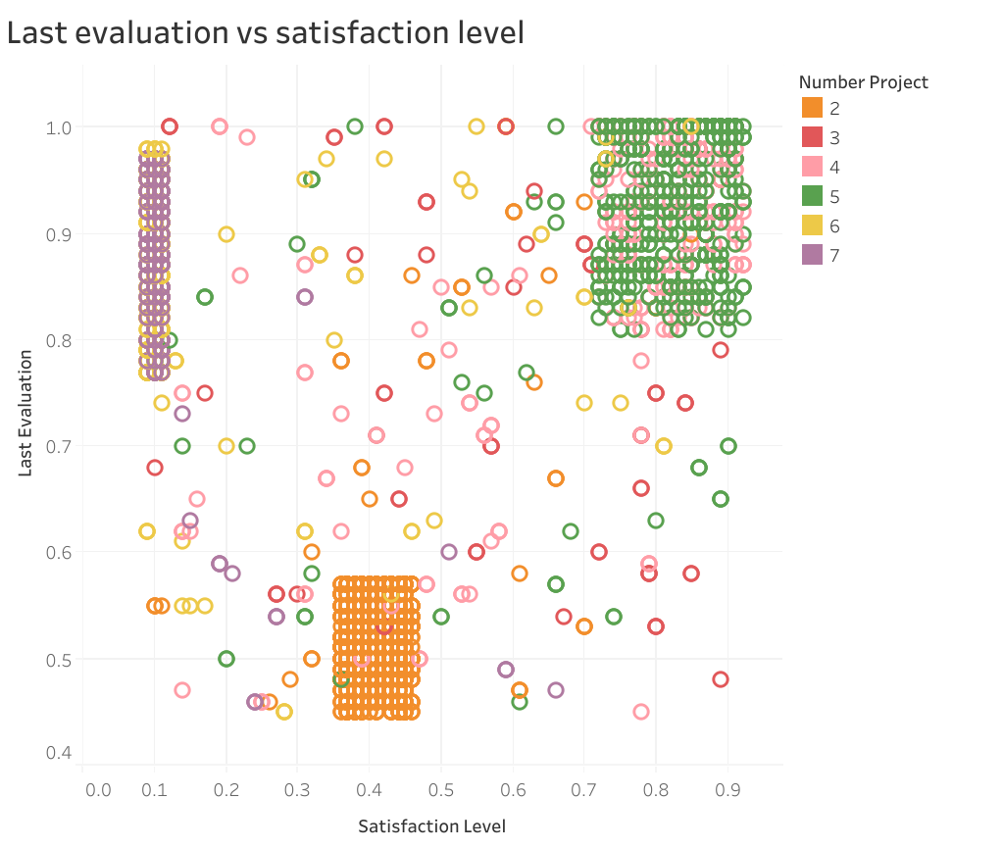

Explorative Analysis
There are 3 clusters of employees
Unsatisfied and overworked employees
Unsatisfied and underworked employees
Satisfied and hardworking employees

Slide 10
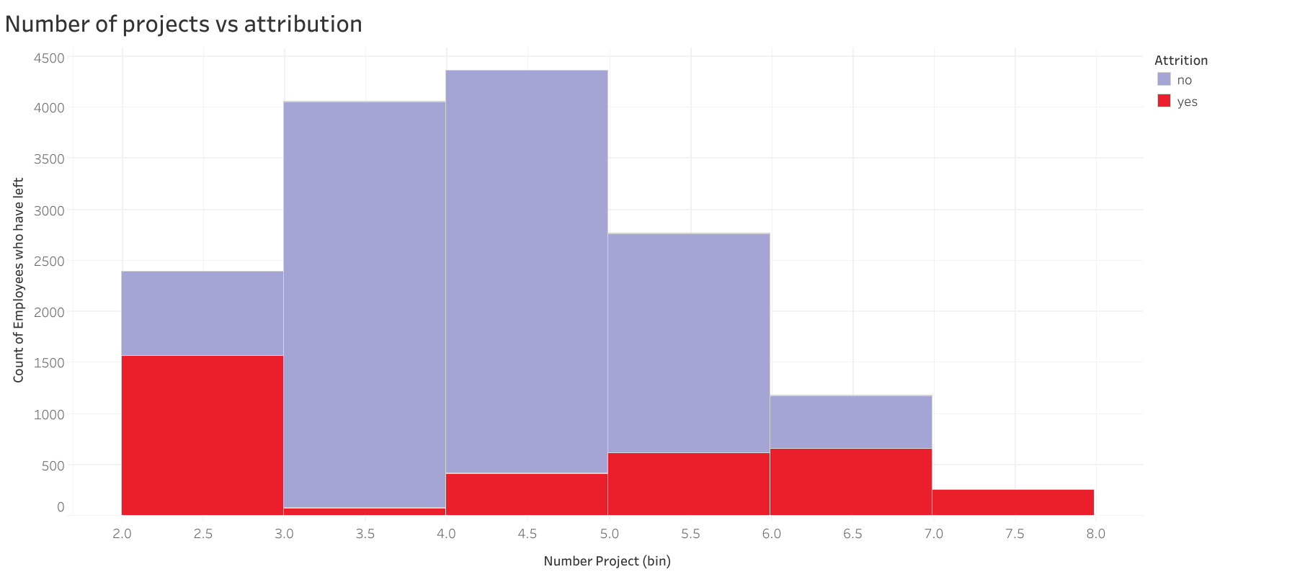
Explorative Analysis
Observations
Employees leaving the most have 2,6,7 projects.
All employees that have 7 projects left.
Are they overworked?
Employees with 3,4,5 projects looks comfortable.

Slide 11
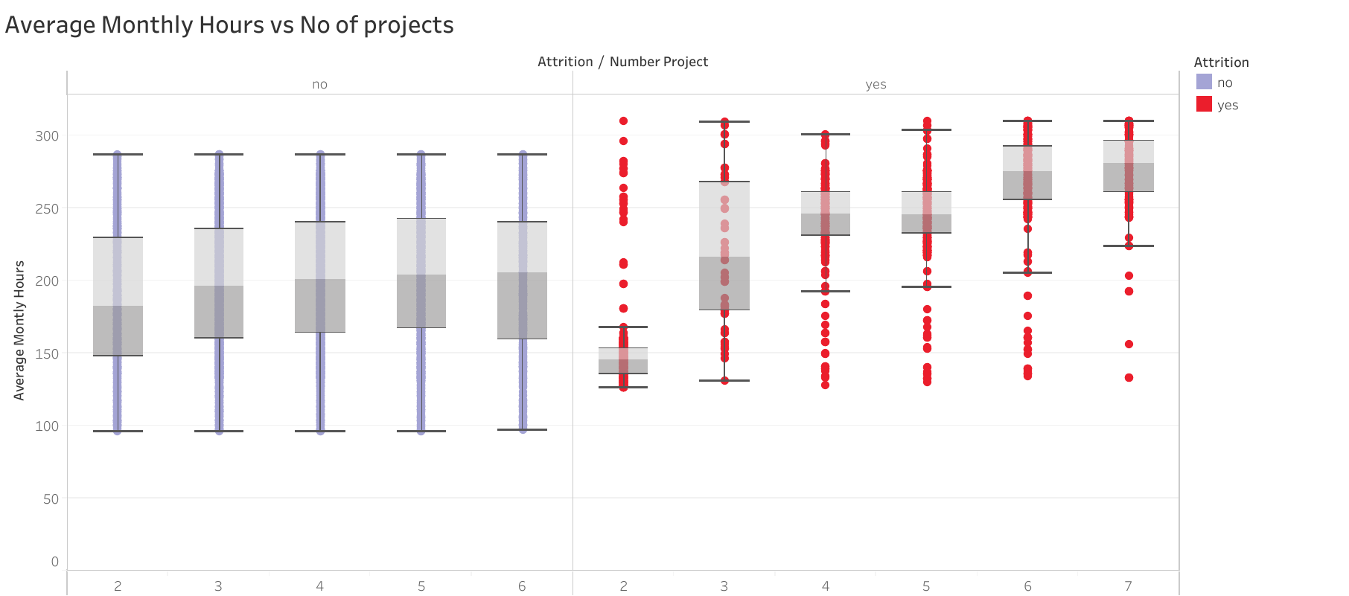
Explorative Analysis of Employees Projects and Average Monthly Hours
Employees that left have higher average monthly hour per projects than their counterparts that stayed.
Employees that left has number of projects increased so does the average monthly hour but this is not same for those that have not left?

Slide 12
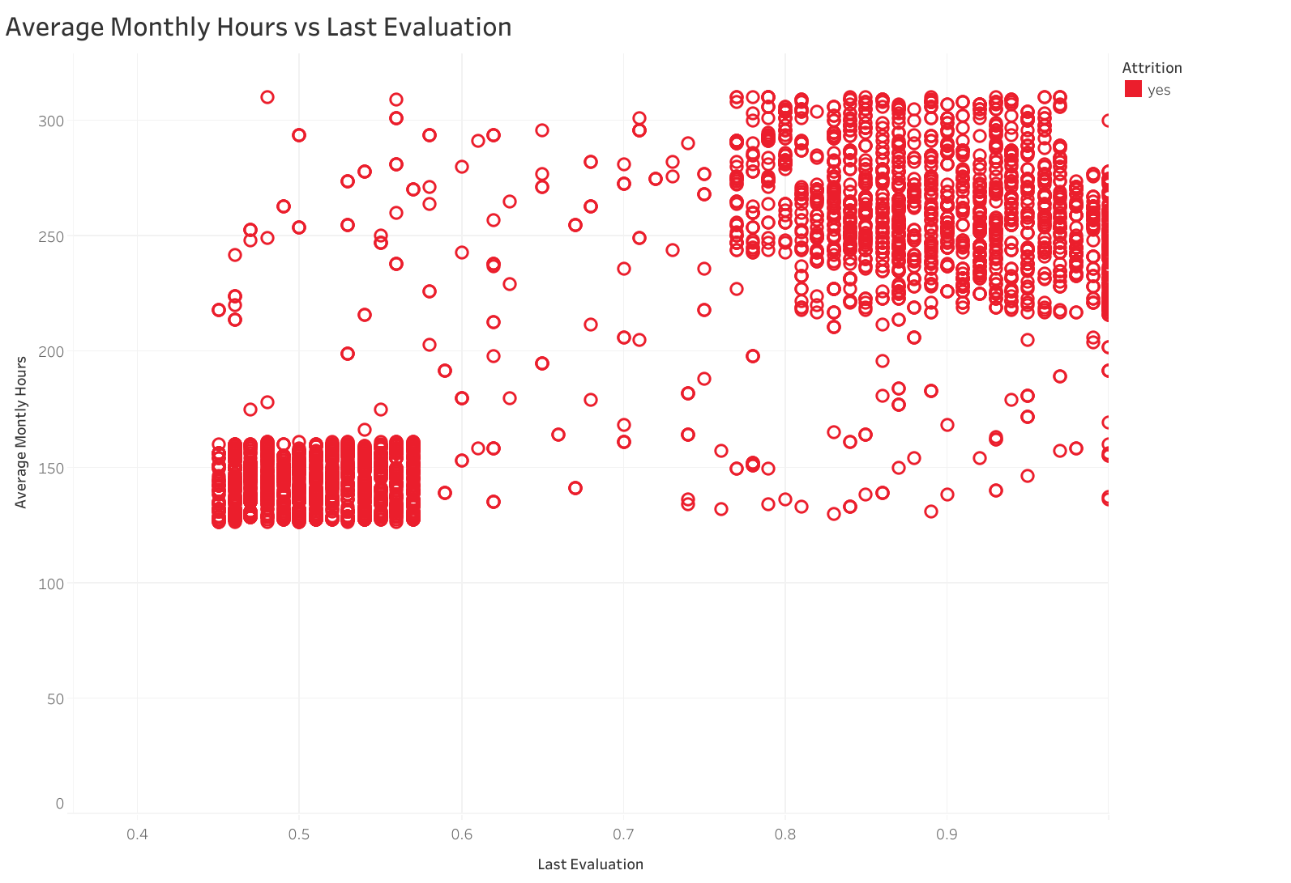
Evaluation of employees based on Avg Montly hours
Employees with lower average monthly hours were evaluated less
Employees with higher monthly hours were evaluated more.

Slide 13
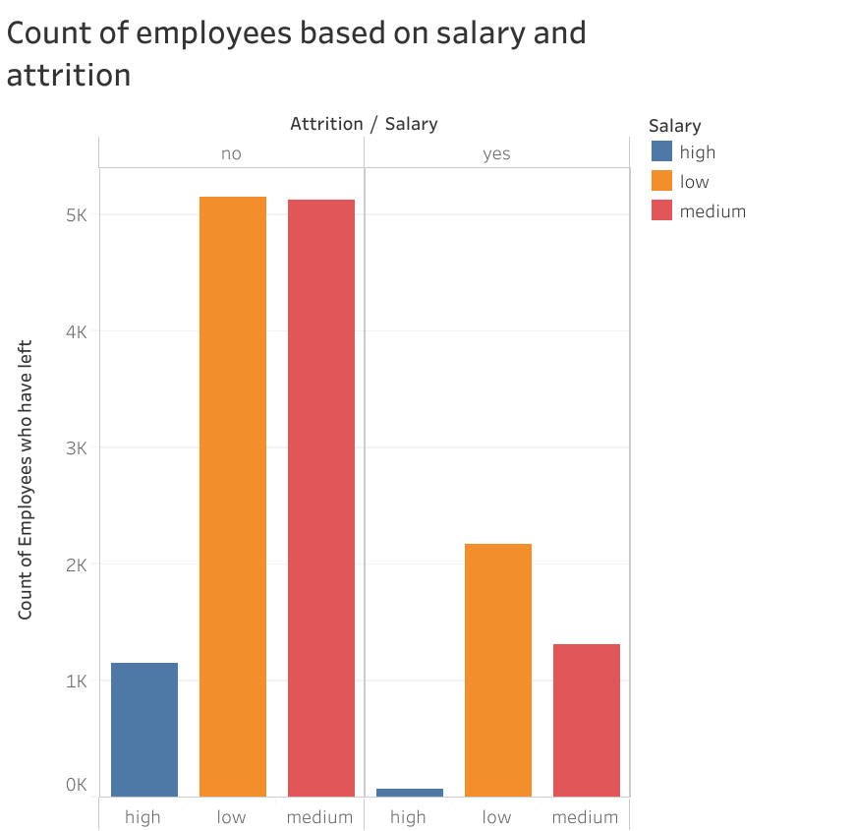
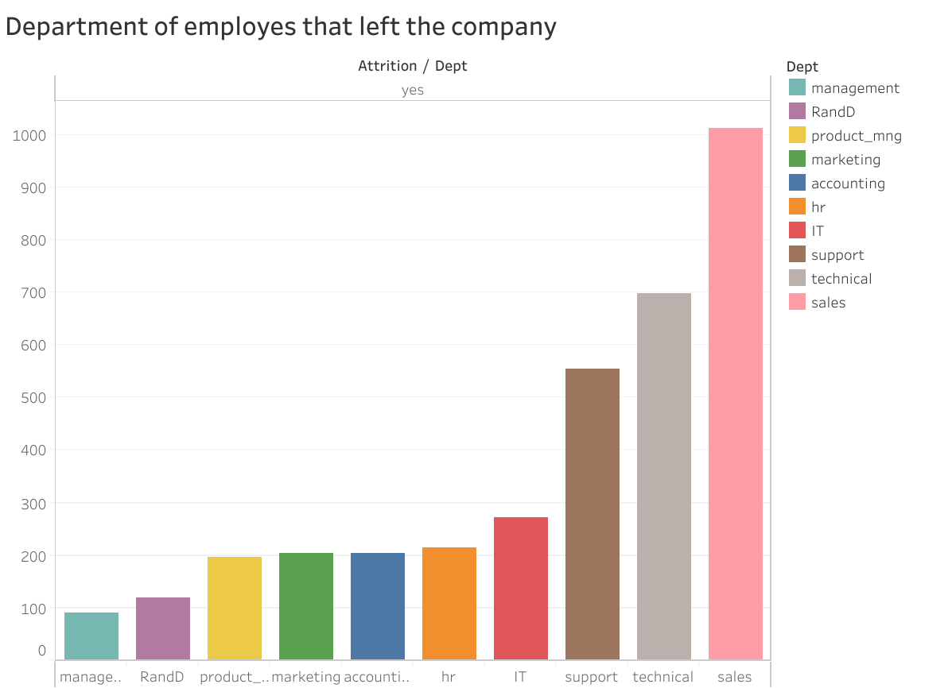
Explorative Analysis

Slide 14
Observation And Recommendations
Why did employees leave?
The employees are leaving because of their satisfaction level.
From insights, those that had low satisfaction level were either underworked or overworked.
What type of employees are leaving?
Employees that are leaving are those with low salary and those from sales, technical and support department.
Employees that are underworked with low evaluations and employees that are overworked with high evaluations and low satisfaction.
Recommendations
Employees with 2, 6, 7 number of projects should be taken into consideration.
Employees in sales, technical and support teams should be taken into consideration.
Employees that have high average monthly hours and more projects
Employees satisfaction level should be maintained across employees by appointing an average amount of projects to all employees so that they don’t get overworked or feel underworked

Slide 15
THANKS!
Hash Analytics Internship.
Next: Predicting the Employees that will leave the company in future

